Slide 1
Infected innate immune cells hint at the cause of severe COVID
Minghao Gong

Slide 2
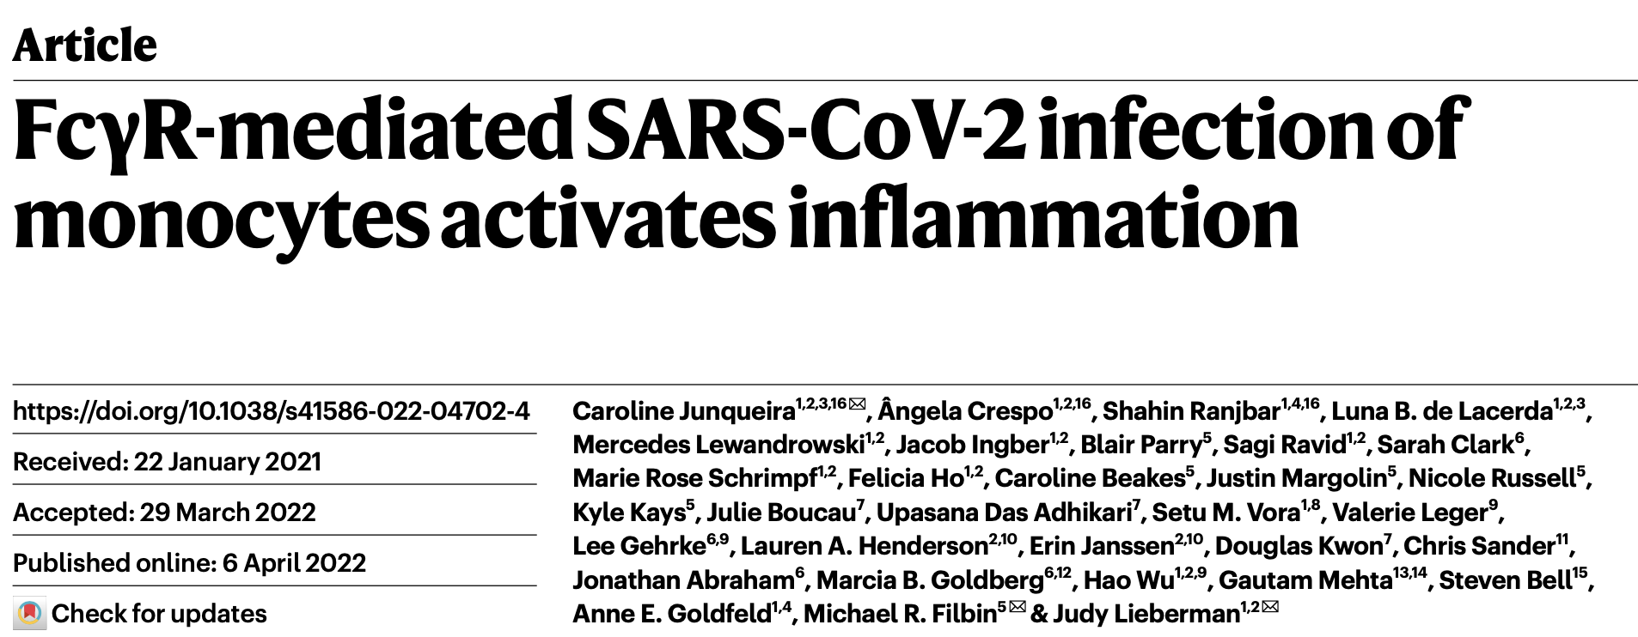

Slide 3
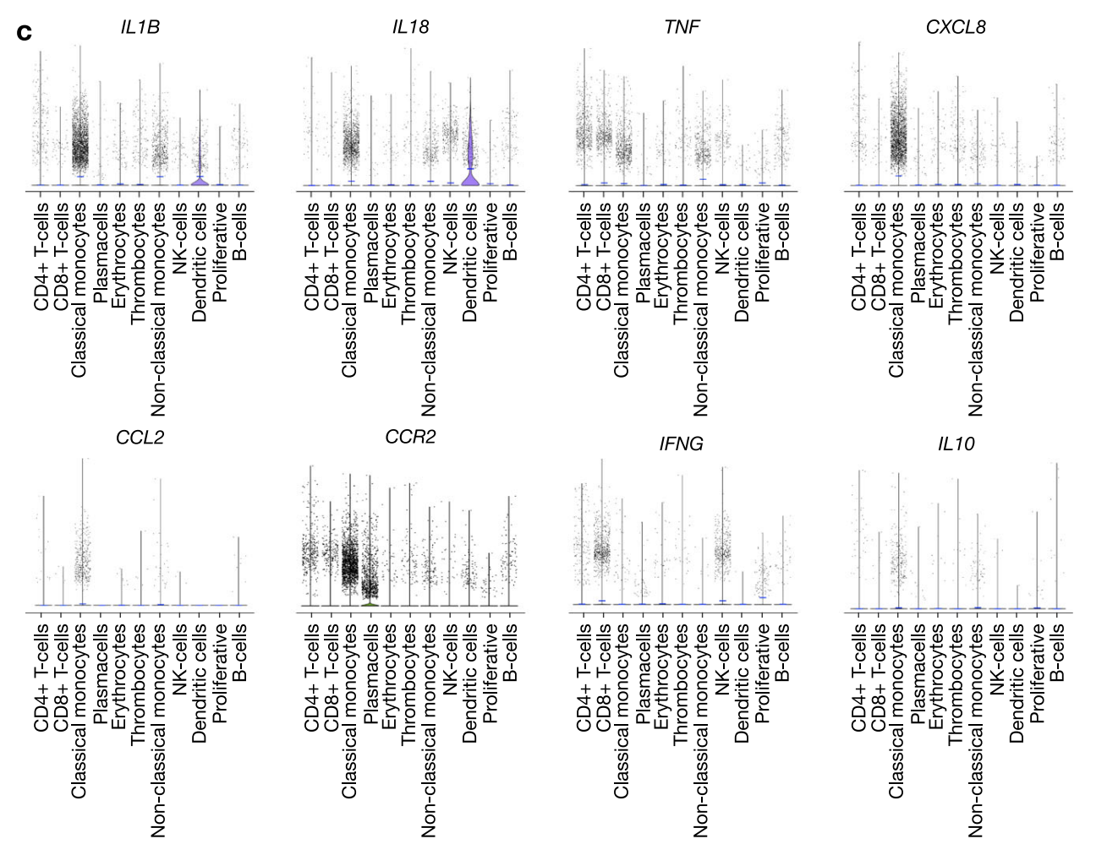
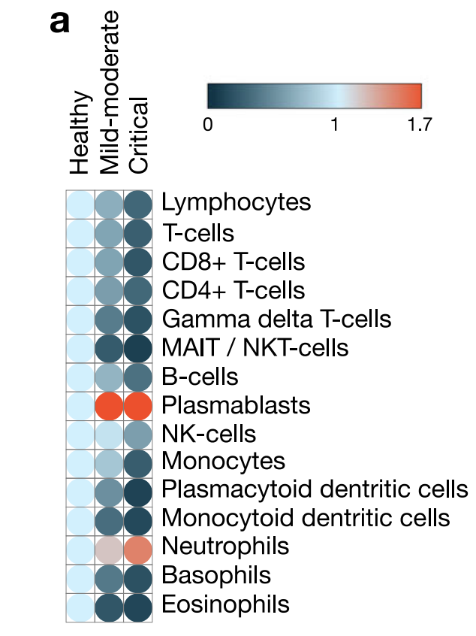
Monocyte-driven atypical cytokine storm and aberrant neutrophil activation as key mediators of COVID-19 disease severity
Reviewer’s question: Myeloid cells are not infected by SARS-CoV-2, yet they are highly pro-inflammatory. Please explain the basis for this in the discussion section.
Vanderbeke et al. 2021. Nat Comm.
Notes:
Substantiating our hypotheses on the cellular origin of cytokine production, scRNA-seq of PBMCs showed that classical monocytes were the main source of major COVID-19 mediating cytokines, including the monocyte chemoattractant CCL2 and its receptor CCR2, the neutrophil chemoattractant CXCL8, and TNF-α. The pro-inflammatory nature of this cell subset is further highlighted by its high expression of inflammasome-associated cytokine coding genes IL1B and IL18 (Fig. 2b, c).
Reviewer’s question: Myeloid cells are not infected by SARS-CoV-2, yet they are highly pro-inflammatory. Please explain the basis for this in the discussion section.
Vabret et al. provide a review of hypotheses based on clinical data obtained during the MERSCoV, SARS-CoV-1 and SARS-CoV-2 epidemics as well as on preclinical data4 . They sketch a framework, in line with our findings, in which the myeloid immune compartment is characterized by an untimely antiviral response, linked to a heightened proinflammatory reaction.
How exactly pathogenic coronaviruses trigger this imbalanced myeloid activation remains a matter of debate. Mechanisms of immune evasion by SARS-CoV-2 have extensively been documented by Lei et al. 5 The resulting delayed IFN signalling and sustained viral replication might promote cytolysis. This in turn might recruit immune cells and induce their cytokine production in a feedforward-loop manner 6. A direct effect of SARS-CoV-2 proteins on epithelial and myeloid cells’ cytokine production however was put forward in an elegant proteomic study, suggesting that SARS-CoV-2 nsp9 and nsp10 can interfere with NKRF (an NF-kB repressor) and stimulate IL-6 and IL-8 production4,7 . SARS-CoV and SARS-CoV-2, but not MERS-CoV, binding to and subsequent downregulation of ACE2 contributes to this proinflammatory signalling.8
Vanderbeke, L., P. Van Mol, Y. Van Herck, F. De Smet, S. Humblet-Baron, K. Martinod, A. Antoranz, et al. “Monocyte-Driven Atypical Cytokine Storm and Aberrant Neutrophil Activation as Key Mediators of COVID-19 Disease Severity.” Nature Communications 12, no. 1 (December 2021): 4117. https://doi.org/10.1038/s41467-021-24360-w.

Slide 4
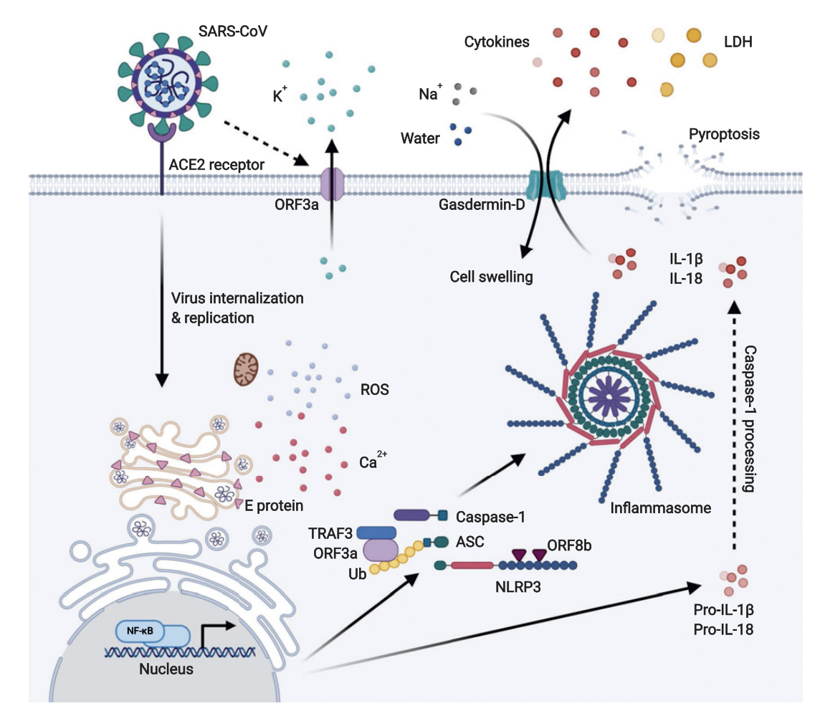
Inflammasome
Jeremy, Iwasaki et al. Journal of Imm. (2020)

Slide 5
Afucosylated Antibodies

Slide 6
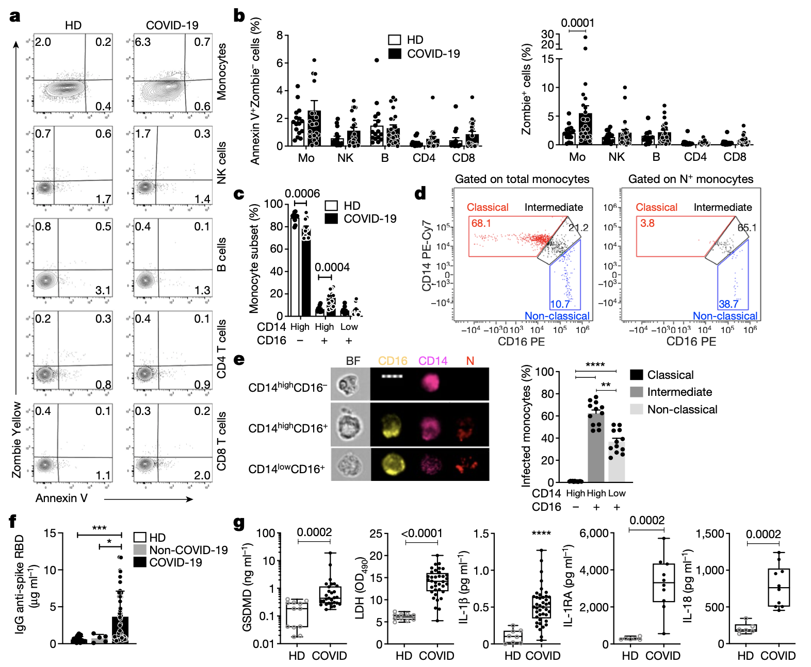
COVID-19 blood shows signs of pyroptosis
Notes:
Fig 1

Slide 7
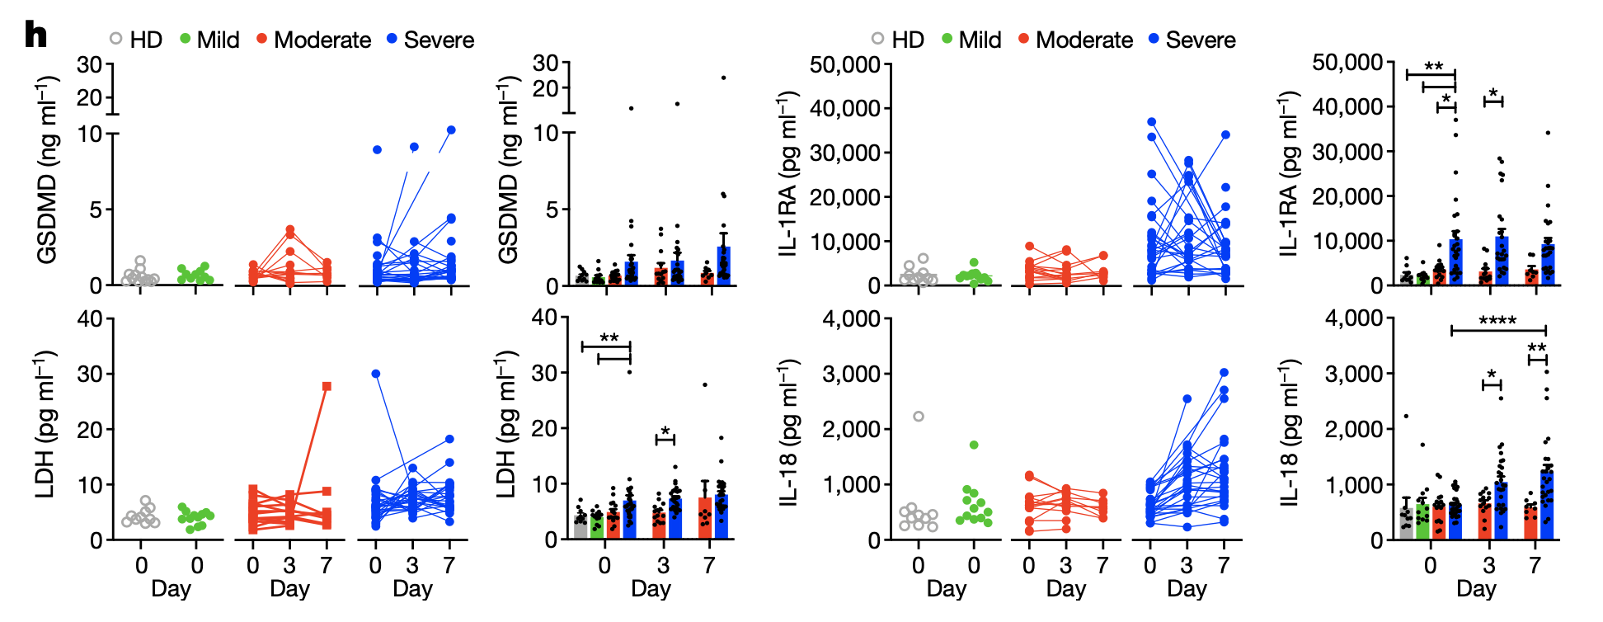
Pyroptosis biomarkers correlate with COVID-19 disease severity
Notes:
Fig 1.

Slide 8
Monocytes have activated inflammasomes

Slide 9
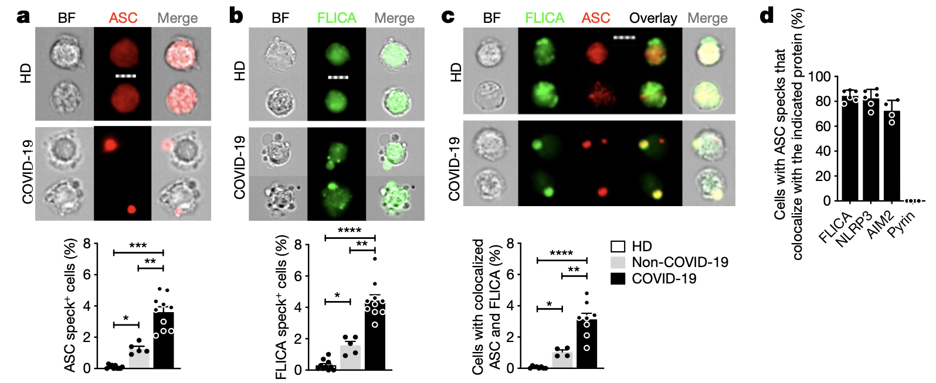
Monocytes have activated inflammasomes –ASC/FLICA

Slide 10
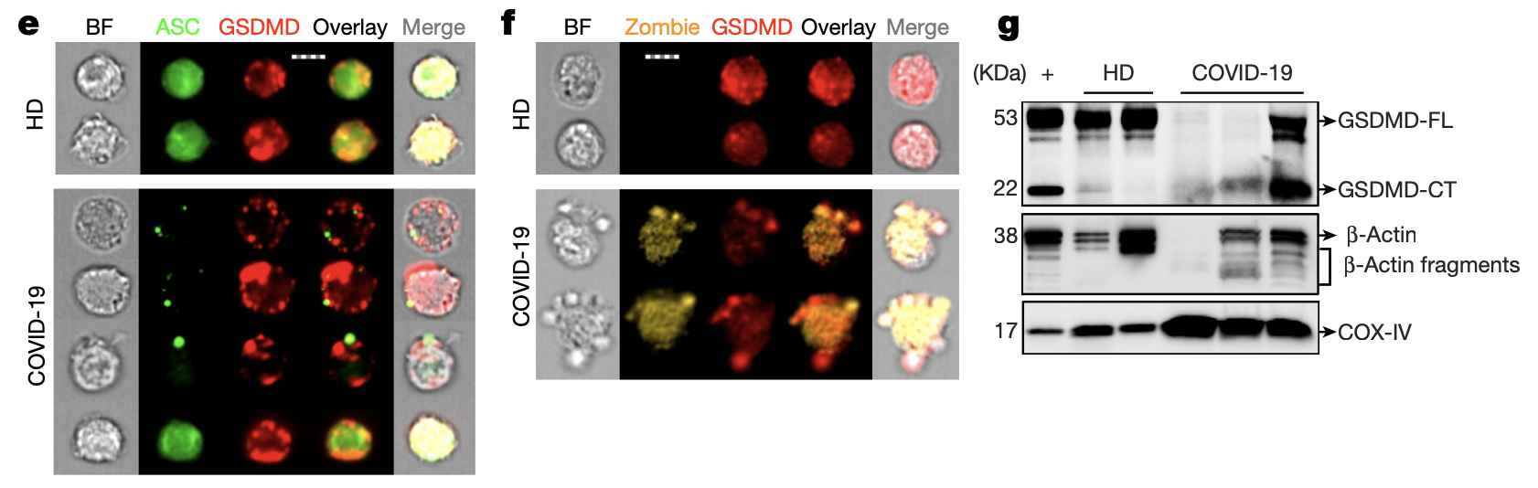
Monocytes have activated inflammasomes – GSDMD

Slide 11
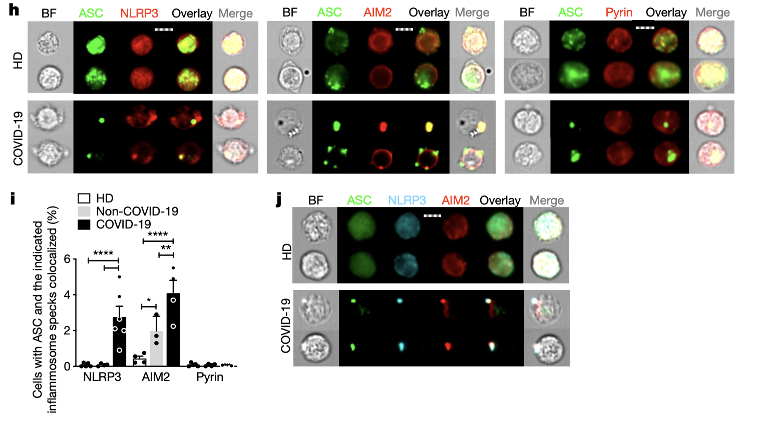
Monocytes have activated inflammasomes – NLPR3/AIM2

Slide 12
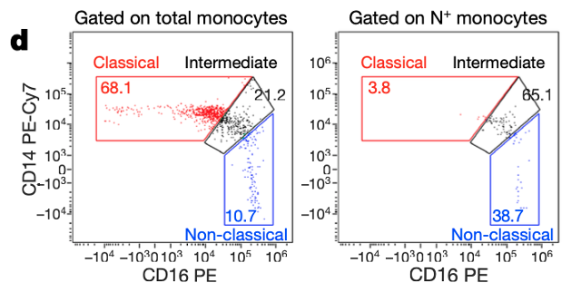
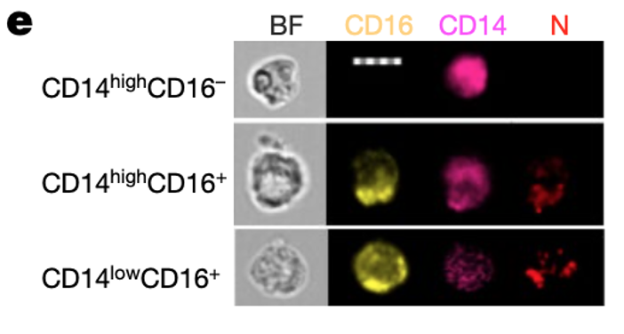
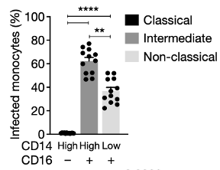
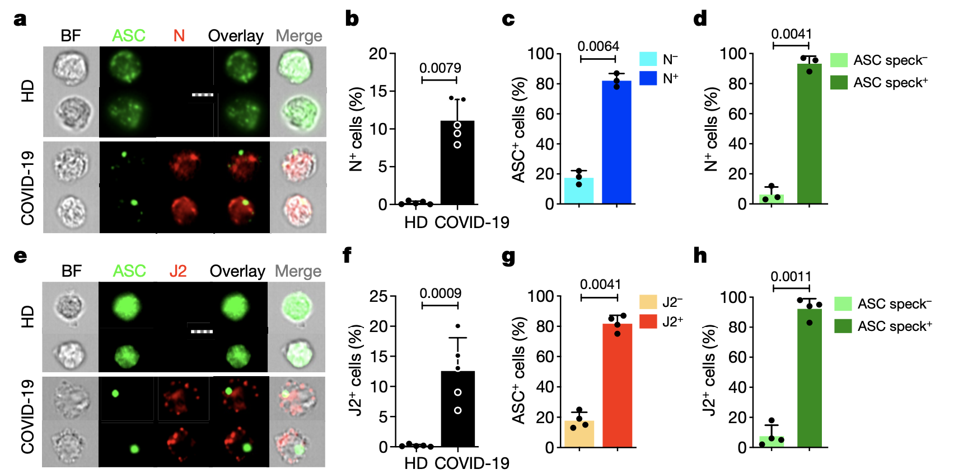
Monocyte infection triggers pyroptosis

Slide 13
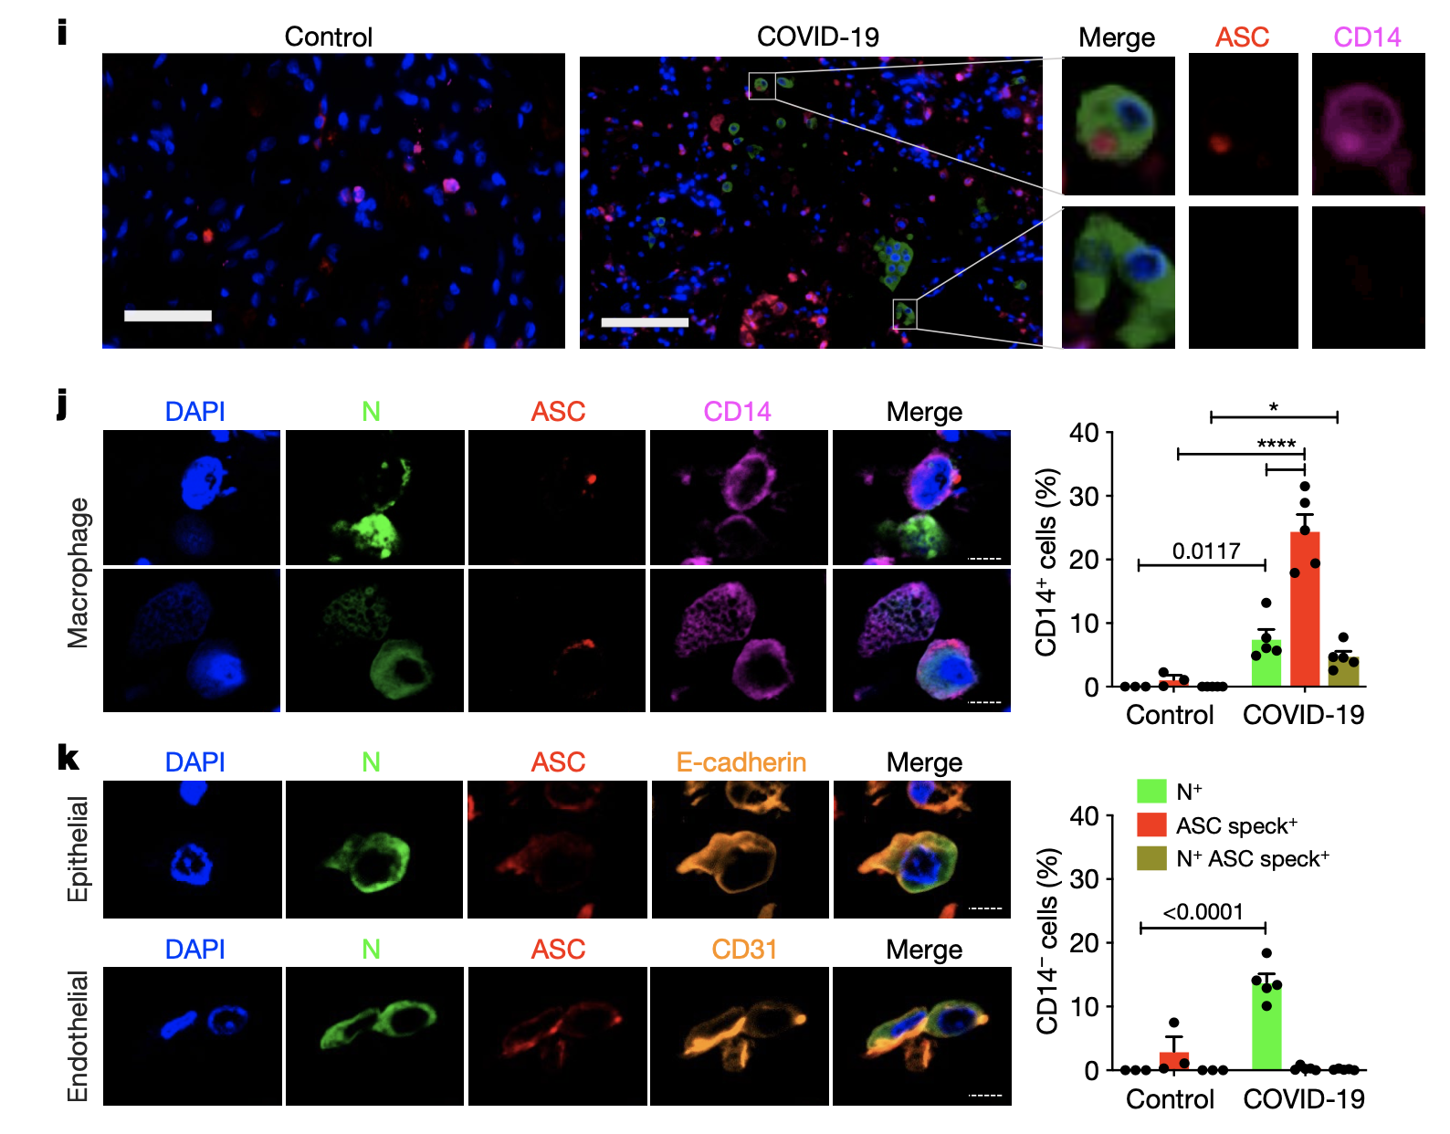
Lung macrophages have inflammasome specks

Slide 14
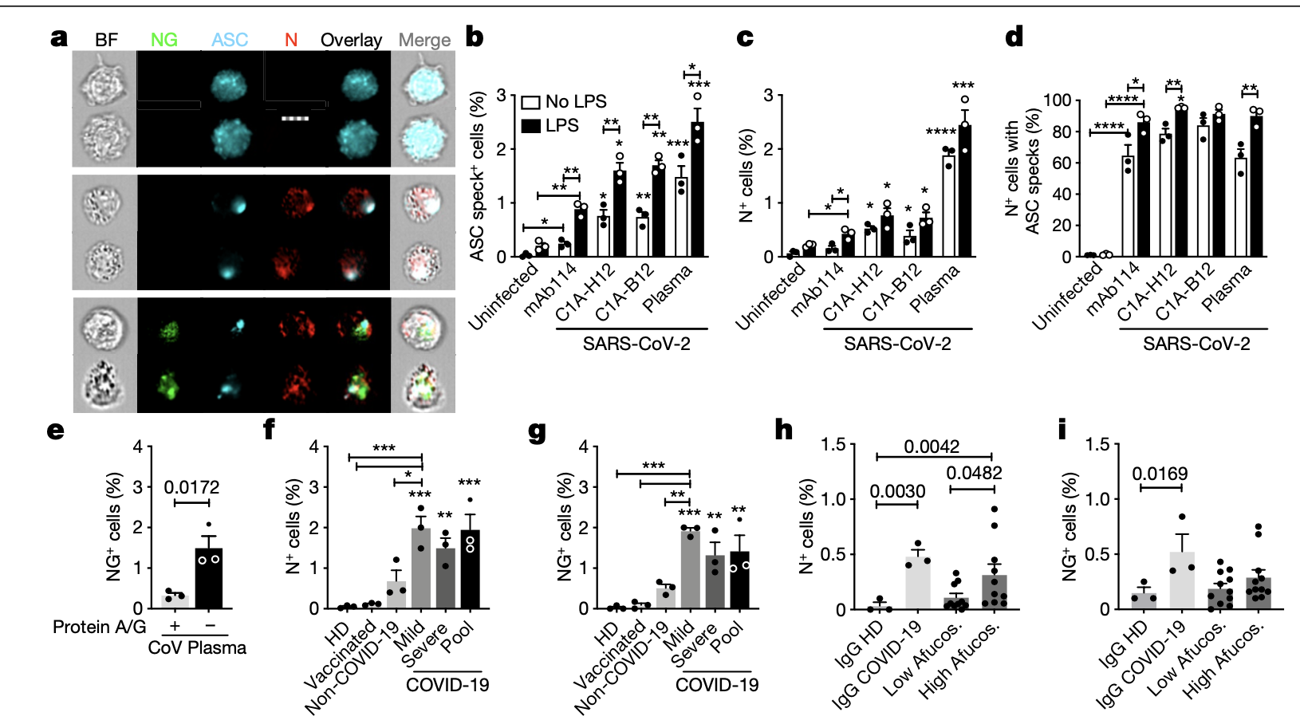
CD16 mediates infection of opsonized virus

Slide 15
How to mechanistically prove the FcR important?

Slide 16
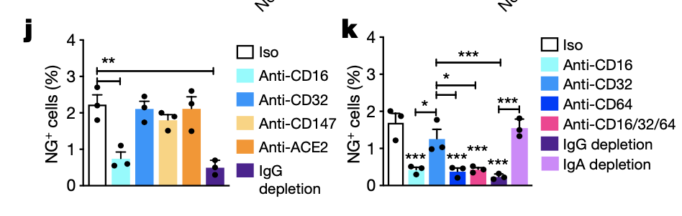

Slide 17
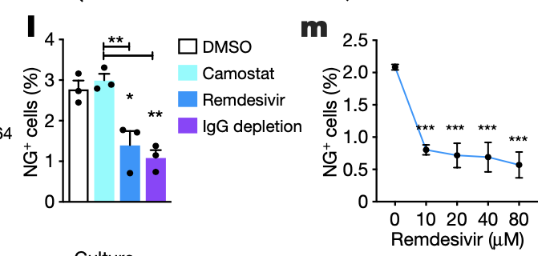
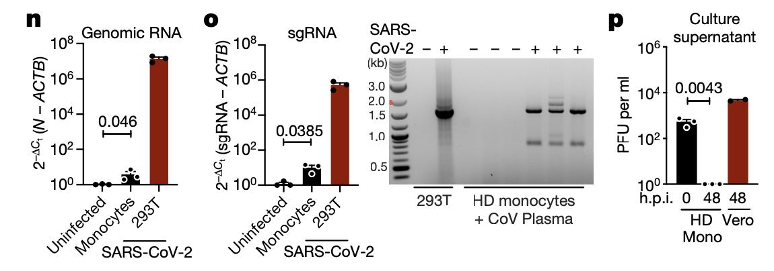
SARS-CoV-2 monocyte infection is aborted

Slide 18
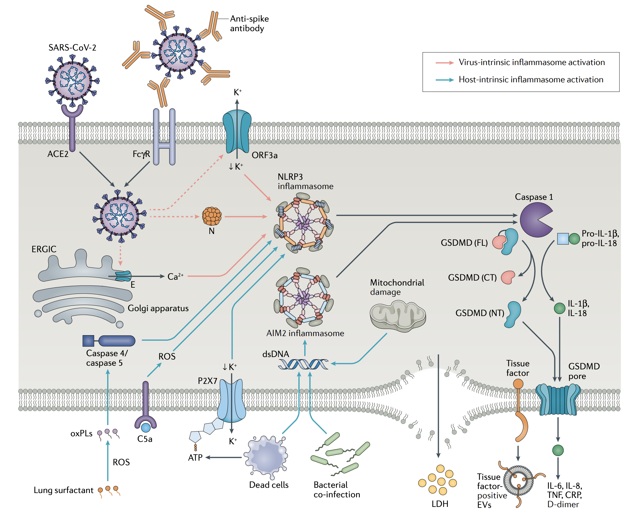
Inflammasome Activation at the Crux of Severe COVID-19
Vora et al. Nat. Rev. Imm. (2021)
Notes:
Fig. 1 | Virus-intrinsic and host-intrinsic mechanisms of inflammasome activation. Virus intrinsic mechanisms (red arrows): severe acute respiratory syndrome coronavirus 2 (SARS-CoV-2) virions enter epithelial cells via angiotensin-converting enzyme 2 (ACE2) and can enter monocytes by binding to anti-spike antibodies followed by Fc receptor for IgG (FcγR)- mediated internalization. Upon translation of the viral genome, the viroporins ORF3a and E can trigger K+ efflux or Ca2+ influx to promote NLRP3 activation. Viral N protein can bind directly to NLRP3, resulting in its activation. Host-intrinsic mechanisms (blue arrows): oxidation of lung surfactant phospholipids results in oxidized phospholipids (oxPLs), which can activate caspase 4 and/or caspase 5 to promote noncanonical inflammasome activation. Complement products such as C5a can activate NLRP3 by promoting accumulation of reactive oxygen species (ROS). ATP released by dead cells binds to P2X7 receptor, which causes K+ efflux and NLRP3 activation. Dead cells, bacterial co-infection or damaged mitochondria can result in cytosolic double-stranded DNA (dsDNA), which activates the AIM2 inflammasome. NLRP3 and AIM2 inflammasome assembly activates caspase 1, which cleaves full-length (FL) gasdermin D (GSDMD) into amino-terminal (NT) and carboxy-terminal (CT) fragments. The GSDMD NT fragment binds to the plasma membrane, oligomerizes and inserts itself as a pore. Caspase 1 also cleaves pro-IL-1β and pro-IL-18 into their mature forms, which are released through the GSDMD pore. IL-1β can activate macrophages to secrete additional proinflammatory cytokines such as IL-6. Pyroptosis results after further membrane damage, which releases lactate dehydrogenase (LDH) and is associated with the formation of tissue factor-enriched extracellular vesicles (EVs). CRP, C-reactive protein; ERGIC, endoplasmic reticulum–Golgi intermediate compartment; TNF, tumour necrosis factor.
Vora, Setu M., Judy Lieberman, and Hao Wu. “Inflammasome Activation at the Crux of Severe COVID-19.” Nature Reviews Immunology 21, no. 11 (November 2021): 694–703. https://doi.org/10.1038/s41577-021-00588-x.

